Slide 1
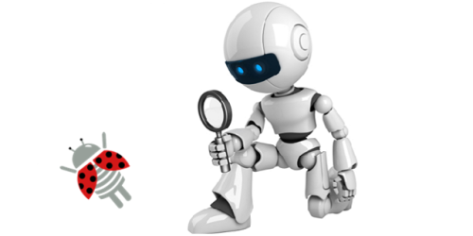
Fundamentals of Testing
Basic Concepts
Dr. Anand Nayyar
E: anandnayyar@duytan.edu.vn
M: 933622812

Slide 2
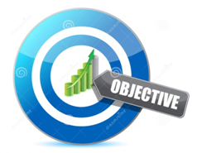
Lesson Objectives
Get to know:
Why is testing necessary?
What is testing?
What is a bug?
General testing principles
Fundamental test process
The psychology of testing
Responsibilities of software tester
Notes:
Mô tả nội dung mà học viên phải đạt được khi kết thúc môn học này

Slide 3

Contents
Why is Testing Necessary?
Software Systems Context
Causes of Software Defects
Role of Testing in Software Development, Maintenance and Operations
Testing and Quality
How Much Testing is Enough?
What is Testing?
Seven Testing Principles

Slide 4

Why is Testing Necessary?

Slide 5
Why test software
dividing 4195835.0/3145727.0 yielded 1.33374 instead of 1.33382, an error of 0.006%.
Cost
AT&T Lines Go Dead (1990) Cost: 75 million missed calls, 200,000 airline reservations lost
Pentium Fails Long Division (1993) Cost: $475 million, corporate credibility
Arianne Rocket Goes Boom (1996) Cost: $500 million
Mars Climate Crasher (1998) Cost: $125 million
EDS Child Support (2004) Cost: £539 million and counting due to over-payment
Notes:
AT&T Lines Go Dead (1990)
Cost: 75 million phone calls missed, 200 thousand airline reservations lost
Disaster: A single switch at one of AT&T’s 114 switching centers suffered a minor mechanical problem and shut down the center. When the center came back up, it sent a message to other switching centers, which in turn caused them to shut down and brought down the entire AT&T network for 9 hours
Pentium Fails Long Division (1993)
Cost: $475 million, corporate credibility
Disaster: Intel’s highly-promoted Pentium chip occasionally made mistakes when dividing floating-point numbers within a specific range. For example, dividing 4195835.0/3145727.0 yielded 1.33374 instead of 1.33382, an error of 0.006%. Although the bug affected few users, it become a public relations nightmare. With an estimated 5 million defective chips in circulation, Intel offered to replace Pentium chips only for consumers who could prove they needed high accuracy. Eventually Intel replaced the chips for anyone who complained.
Cause: The divider in the Pentium floating point unit had a flawed division table, missing about five of a thousand entries and resulting in these rounding errors.
Ariane Rocket Goes Boom (1996)
Cost: $500 million
Disaster: Ariane 5, Europe’s newest unmanned rocket, was intentionally destroyed seconds after launch on its maiden flight. Also destroyed was its cargo of four scientific satellites to study how the Earth’s magnetic field interacts with solar winds.
Mars Climate Crasher (1998)
Cost: $125 million
Disaster: After a 286-day journey from Earth, the Mars Climate Orbiter fired its engines to push into orbit around Mars. The engines fired, but the spacecraft fell too far into the planet’s atmosphere, likely causing it to crash on Mars.
Cause: The software that controlled the Orbiter thrusters used imperial units (pounds of force), rather than metric units (Newtons) as specified by NASA.

Slide 6
Why test software?
Death
2000 - National Cancer Institute, Panama City. Therapy planning software created by Multidata Systems Intl. miscalculates dosage of radiation for patients; 8 deaths

Slide 7



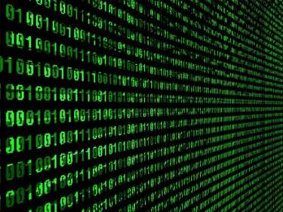
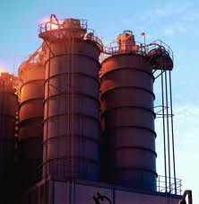

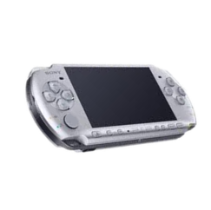
Software Systems Context
Software systems are integral part of every sphere of our life
Education
Industry
Business
Industry
Military
Entertainment
Notes:
Hệ thống phần mềm là một phần không thể thiếu của mọi lĩnh vực của cuộc sống của chúng tôi

Slide 8
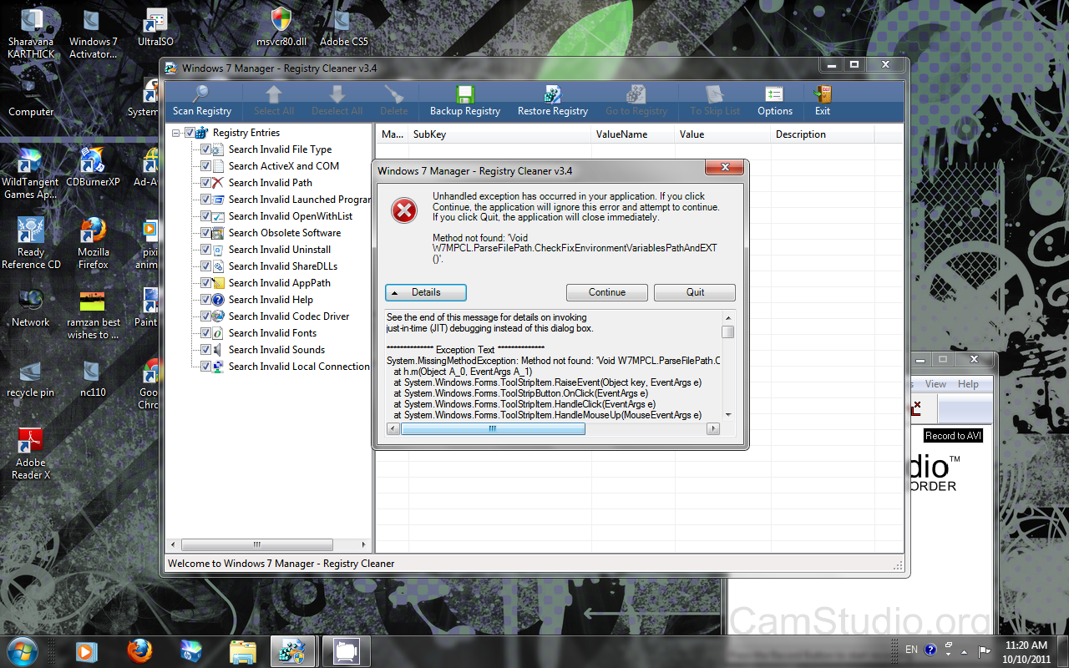
Unhandled exceptions
Unhandled exceptions

Slide 9
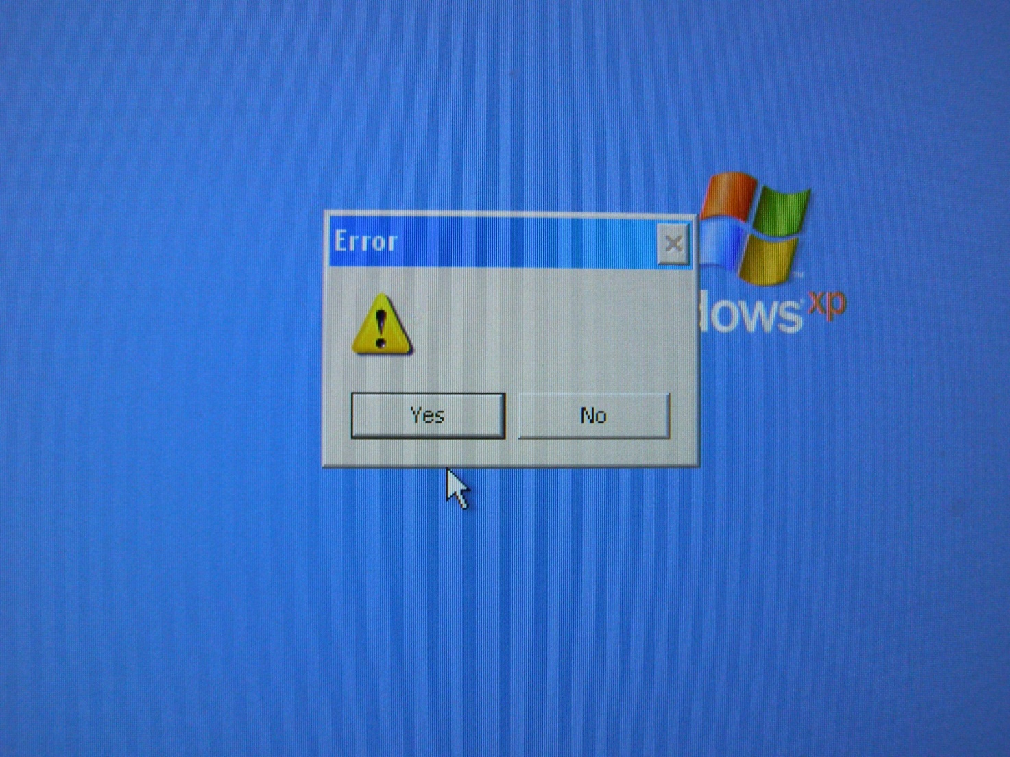
Error handling

Slide 10
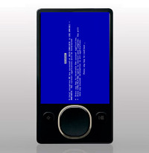
Functional Issues

Slide 11
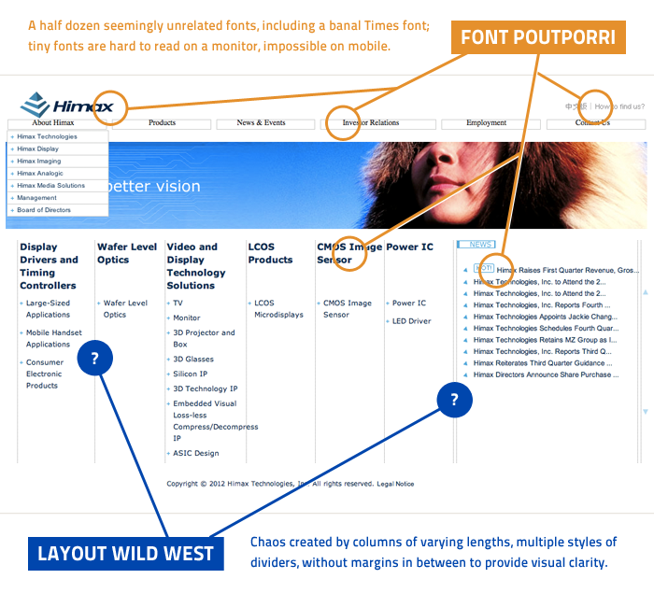
Usability

Slide 12
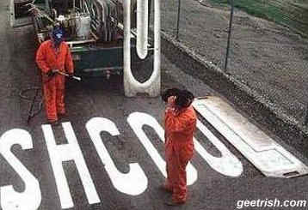

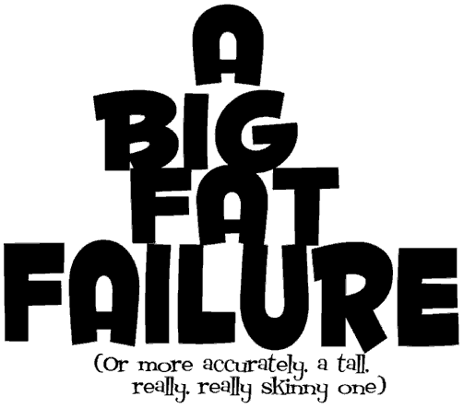
Causes of Software Defects
A human being can make an error (mistake)
Errors produce defects
Defects are faults / bugs in the program code, or in a document
If a defect in code is executed, that might cause a failure:
Fail to do what it should do
Do something it shouldn’t

Slide 13
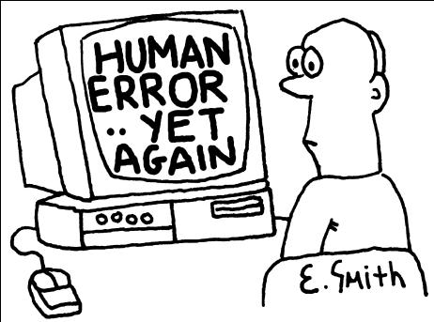

Causes of Software Defects (2)
The human factor
Humans make mistakes
Poor training
Time pressure
Code complexity
Complexity of infrastructure
Changing technologies

Slide 14
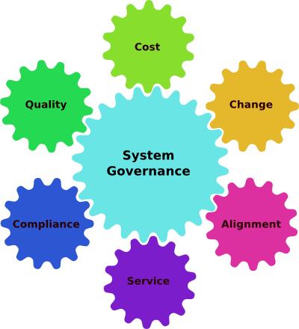
Causes of Software Defects (3)
Organizational factors
Inefficient communication
Unclearly defined requirements
Environmental conditions
Radiation, Magnetism, Electronic fields, Pollution, Etc.
These can change the hardware conditions

Slide 15
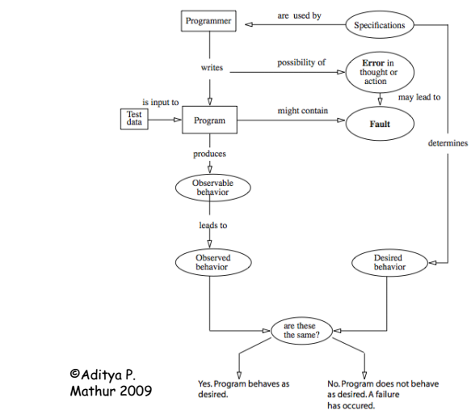
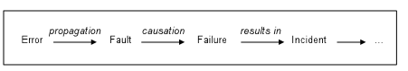
Software Error, faults, failures

Slide 16
Terminology
?
TEST
ERROR
?
?
FAULT
DEBUG
FAILURE

Slide 17
Error vs. Fault vs. Failure
Fault : It is a condition that causes the software to fail to perform its required function.
Error : Refers to difference between Actual Output and Expected output.
Failure : It is the inability of a system or component to perform required function according to its specification.
IEEE Definitions
Failure: External behavior is incorrect
Fault: Discrepancy in code that causes a failure.
Error: Human mistake that caused fault

Slide 18
Error vs. Fault vs. Failure (2)
Fault (defect, bug)
Abnormal condition that may cause a reduction in, or loss of, the capability of a functional unit to perform a required function
A fault is the cause of an error
Failure
The inability of a system to perform its required functions within specified performance requirements

Slide 19

What is Software Quality?
Definition found in IEEE Standard Glossary Of Software Engineering Terminology
The degree to which a system, component, or process meets specified requirements
The degree to which a system, component, or process meets customer or user needs or expectations

Slide 20
The Role of Testing
Role of testing in software development, maintenance and operations
Reduce the risk of problems
Reduce long-term defect-related costs
Contribute to the quality of the software
Help meeting standards:
Contractual or legal requirements
Industry-specific standards

Slide 21

Testing and Quality
Testing can give confidence in the quality of the software if it finds few or no defects
If defects are found, the quality increases when those defects are fixed
Lessons learnt from previous mistakes improve future performance

Slide 22
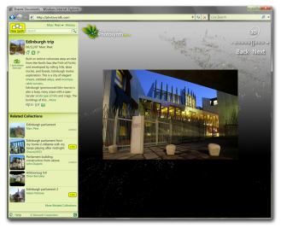

Two Spheres of Quality
Engineering
Customer
Experience
Notes:
Duration: 5-60 mins ( These two slides can be used in brief overview or in-depth activity)
Meta points:
Engineering group will have variety of locally socialized notion of ‘quality’
Customer Defined Quality (CDQ) focuses on ‘functionality and value’
Engineering Quality focuses on efficiency of activity and artifacts
Not 1:1 mapping of EQ & CDQ; Reconciliation is difficult but necessary
The 9 Quality domains is a common taxonomy that provides a pivot point from the engineering activities to the entire product/service ecosystem.
More here: http://sharepoint/sites/twcteam/twcs/Wiki/Domains.aspx
Engineering quality (EQ) is a broad term summarized through a defining phrase: ‘absence of rework’.
Most engineering activities (spec’ing, testing, coding, audits…) associated with the production of software solutions fall under the label Engineering Quality.
Generally engineering activities produce by-products (specs, tests, code) that are the artifacts of engineering activity therefore EQ is often the measures of efficiency of activity and characteristics of artifacts ( E.g. lines of code/week; tests/codeblock; code churn; bugs per branch, size).
EQ often becomes the defacto denominator for risk equations since they are further upstream in the production cycle and can become predictors (e.g. telemetry) and confidence omens.
Customer Defined Quality (CDQ) is focused around ‘functionality and value’ (compatibility, performance, privacy, readiness reliability, security, support, usability, value/desirability) whose pedigree is Marketing research of quality perceptions from customers.
Customers care about whether the software solves their problem or enables them to accomplish their tasks. Customer perception of quality is based largely on their emotional reaction to using the software. It solves their problems.

Slide 23
Quality Domains
Compatibility
Performance
Privacy
Readiness
Reliability
Security
Support
Usability
Value
The product/service works well with previous versions and with other products/services and devices, file formats, etc. Existing applications and devices should run well on the new release
The product/service should be responsive, efficient and scalable. This also describes how the product/service performs overall with regard to customer experience
When using the product/service, the machine, application and data are safe and secure. Personal data is secure and users control how it is used
The product/service should perform seamlessly in any location in the world and be easy to configure, deploy, monitor, and service the product. Includes practices for world-readiness, geopolitical and others like industry regulatory compliance, etc.
The product/service should operate with few disruptions, recover gracefully and withstand certain failures. Product/service behavior is predictable, durable, dependable, does what expected, rarely stops working or crashes and recoverable
The product/service should protect users against attacks via known and unknown vulnerabilities. When using the product/service your machine/apps/data are safe
When problems are encountered, the product/service has good technical support. Relevant help is available when the user needs it and easy to leverage
The product/service interface should be easy-to-use and intuitive to learn. The product/service is easy to install, operate and manage
The product/service functionality provides good value for the price
Notes:
The quality domains are a good set of test categories to think about that are used. Your team will probably have these built into your test spec template. If your template is missing some of these, you can help by adding them.
These quality domains are the ones that stood out as mattering the most to customers.

Slide 24
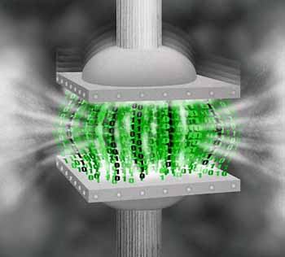
How Much Testing is Enough?
How much testing should be done is a matter of risk:
Too much testing can delay the product release and increase the product price
Insufficient testing hides risks of errors in the final product

Slide 25
Why Testing is Necessary
Why don’t we test everything ?
System has 20 screens
Average 4 menus / screen
Average 3 options / menu
Average of 10 fields / screen
2 types of input per field
Around 100 possible values
Approximate total for exhaustive testing
20 x 4 x 3 x 10 x 2 x 100 = 480,000 tests
Test length = 1 sec then test duration = 17.7 days
Test length = 10 sec then test duration = 34 weeks
Test length = 1 min then test duration = 4 years
Test length = 10 mins then test duration = 40 years!
It is not a matter of time. But,time is money ( salary is taken by hour. So second is valuable for software houses)
Notes:
END - So clearly you can’t test everything!

Slide 26
Urgency of Equilibrium
If you test too little, the probability of software failure increases
If you try to test too much, the development cost becomes unaffordable
So, we need to conduct some sort of equilibrium
Number of
Missed Bugs
Cost of
Testing
Quantity
Under
Testing
Testing
Equilibrium
Over
Testing
Amount of Testing

Slide 27
When should we Stop Testing
Most common factors helpful in deciding when to stop the testing are:
1) Stop the Testing when deadlines like release deadlines or testing deadlines have reached
2) Stop the Testing when the test cases have been completed with some prescribed pass percentage.
3) Stop the Testing when the testing budget comes to its end.
4) Stop the Testing when the code coverage and functionality requirements come to a desired level.
5) Stop the Testing when bug rate drops below a prescribed level
6) Stop the Testing when the period of beta testing / alpha testing gets over.

Slide 28

What Is Testing?

Slide 29
What is Testing?
What is testing?
The process of exercising software
To verify that it satisfies specified requirements and to detect errors
The process of analyzing a software item
To detect the differences between existing and required conditions (that is, bugs),
To evaluate the features of the software item
Notes:
http://www.aptest.com/glossary.html

Slide 30

What is Testing? (2)
What is testing?
The process of operating a system or component under specified conditions
Observing or recording the results
Making an evaluation of some aspect of the system or component
Notes:
http://www.aptest.com/glossary.html

Slide 31
Definitions
Commonly accepted
Myers: “Testing is the process of executing a program with the intent to find errors.”
IEEE: Testing is the process of operating a system or component under specified conditions observing or recording results, and making an evaluation of some aspect of the system or component.
Jorgensen:
“Demonstrate it works”
“Prove it has bugs”

Slide 32

Main Test Activities
Testing is not just running tests, but also:
Planning and control
Choosing test conditions
Designing and executing test cases
Checking results
Evaluating exit criteria
Reporting on the testing process and system under test
Finalizing or completing closure activities

Slide 33

Main Objectives in Testing
Testing pursues several objectives:
Finding defects
Gaining confidence about the level of quality
Providing information for decision-making
Preventing defects

Slide 34
Different Viewpoints
Objectives of testing differ according to the point of view:
Developers
Are perceived as very creative - they write code without which there would be no system
Are rarely good communicators
Can often specialize in just one or two skills (e.g. VB, C++, JAVA, SQL)
Notes:
Positive Testing: Operate application or software as it should be operated. Use proper variety of test data, including data values at boundries to test if it fails. Check actual test results with the expected and see
- Does it behave normally? - Are results correct? - Does the software function correctly?
Negative Testing: Test for abnormal operations. Test with illegal / abnormal test data. Intentionally attempt to make things go wrong and to discover / detect and see
- Does the system fail / crash? - Does the program do what it should not? - Does it fail to do what it should?

Slide 35
Different Viewpoints
Objectives of testing differ according to the point of view:
QA testers
Are perceived as destructive - only happy when they are finding faults!
Usually require good communication skills, tact & diplomacy.
Normally need to be multi-talented (technical, testing, team skills).

Slide 36
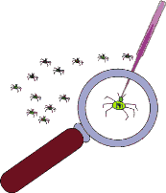

Debugging VS Testing
Testing
The activity that initially finds failures in a software item
Debugging
The development activity that finds, analyses and removes the cause of the failure
Subsequent re-testing by a tester
Ensures that the fix does indeed resolve the failure

Slide 37

Seven Testing Principles

Slide 38

Seven Testing Principles (1)
Testing shows presence of defects
Testing can show that defects are present
Cannot prove that there are no defects
Appropriate testing reduces the probability for defects

Slide 39

Seven Testing Principles (2)
Exhaustive testing is impossible
All combinations of inputs and preconditions are usually almost infinite number
Testing everything is not feasible
Except for trivial cases
Risk analysis and priorities should be used to focus testing efforts

Slide 40
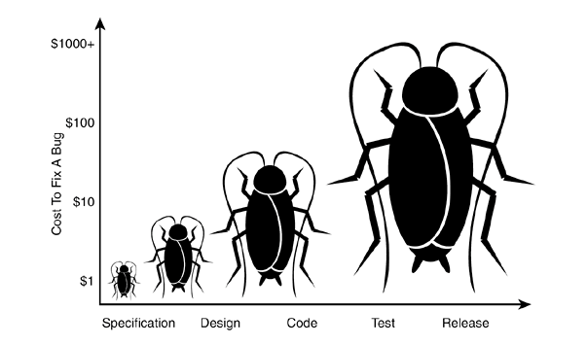
Seven Testing Principles (3)
Early testing
Testing activities shall be started as early as possible
And shall be focused on defined objectives
The later a bug is found – the more it costs!

Slide 41
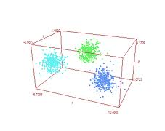
Seven Testing Principles (4)
Defect clustering
Testing effort shall be focused proportionally
To the expected and later observed defect density of modules
A small number of modules usually contains most of the defects discovered
Responsible for most of the operational failures
Notes:
In your opinion which operation is most likely to cause your Operation system to fail?
- Opening Microsoft Word
- Open IE
- Opening 10 different application all at the same time

Slide 42

Seven Testing Principles (5)
Pesticide paradox
Same tests repeated over and over again tend to loose their effectiveness
Previously undetected defects remain undiscovered
New and modified test cases should be developed

Slide 43
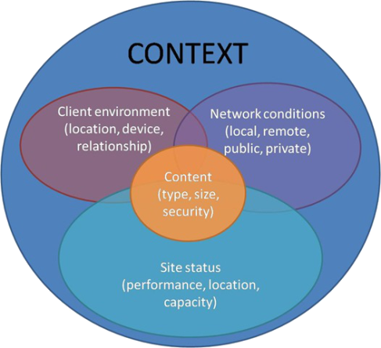
Seven Testing Principles (6)
Testing is context dependent
Testing is done differently in different contexts
Example: safety-critical software is tested differently from an e-commerce site

Slide 44
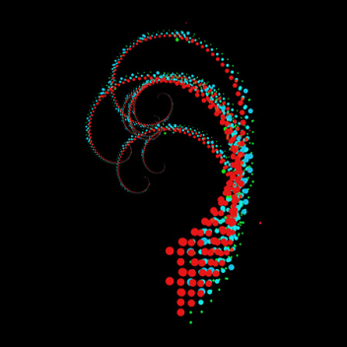

Seven Testing Principles (7)
Absence-of-errors fallacy
Finding and fixing defects itself does not help in these cases:
The system built is unusable
Does not fulfill the users’ needs and expectations

Slide 45


Psychology of Testing
Traits of Good Testers
A Tester needs:
good communication skills
good observation skills
people handling skills
Curiosity ( testing activities interest )
patience
reliability
Thoroughness ( carefulness)
an inquisitive nature
attention to detail
creativity in terms of identifying likely faults
Experience
However as with most other disciplines an effective test team will need a mix of skills so it is difficult to generalise
Notes:
Maybe also perseverance?

Slide 46
Fundamentals of Testing
?
?
?
?
?
Questions?
?
?
?
?
?
?

Slide 47
Exercises
A test team consistently finds between 90% and 95% of the defects present in the system under test. While the test manager understands that this is a good defect-detection percentage for her test team and industry, senior management and executives remain disappointed in the test group, saying that the test team misses too many bugs. The users are generally happy with the system and the failures which have occurred have generally been low impact.
Continues …

Slide 48
Exercises (2)
Which of the following testing principles is most likely to help the test manager explain to these managers and executives why some defects are likely to be missed?
Exhaustive testing is impossible
Defect clustering
Pesticide paradox
Absence-of-errors fallacy

